Slide 1
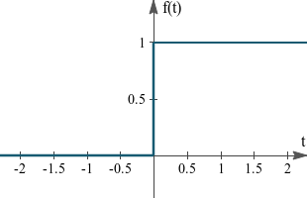
W_{1,1}
W_{1,0} (-b₁)
×
W_{2,1}
Σ₁
y₁
X₁
×
(0,1)
W_{3,1}
W_{2,0} (-b₂)
.
.
.
×
y₂
Σ₂
W_{1,N}
(0,1)
×
W_{2,N}
W_{3,0} (-b₃)
X_{N}
×
y₃
Σ₃
W_{3,N}
(0,1)
×

